Slide 1

NEIL GOGTE INSTITUTE OF TECHNOLOGY
A Unit of Keshav Memorial Technical Education (KMTES)
(Approved by AICTE, New Delhi & Affiliated to Osmania University, Hyderabad). D.No.10 TC-111, Kachavanisingaram Medchal – Malkajgiri - 500088
Brain Tumor Classification and Detection using MRI Scan Images
MAJOR PROJECT
PRESENTED BY
THAKKALAPALLY SAI SUSHANTH - 245318733110
SARVARAJU SAI KARTHIK - 245318733104
INTERNAL GUIDE
Mrs.M.Meenakshi
Assistant Professor

Slide 2


Contents:
Abstract
Aim of the project
Introduction
System/User requirements
Tools and Technologies
Functional Requirements
Non-Functional Requirements
Existing system and Proposed system
Architecture
UML Diagram
Results
Conclusion
References

Slide 3
ABSTRACT
A Brain tumor is considered as one of the most aggressive diseases and its segmentation is most crucial tasks in the terrain of medical image processing.
Human-assisted manual classification for prediction and diagnosis of Tumor is inaccurate. Proper treatment, planning, and accurate diagnostics should be implemented to improve the life expectancy of the patients.
The best technique to detect brain tumors is Magnetic Resonance Imaging (MRI).
In this project, Convolution Neural Network (CNN) is applied in detecting the presence of brain tumor and their performance is analysed.
This distinguishes between normal and abnormal pixels, based on texture and statistical features. This improves the performance, minimises the complexity and works on real time data.

Slide 4
PROJECT AIM
To detect and classify brain tumor
Improvement of MRI scanning process
For accurate diagnosis

Slide 5
INTRODUCTION
Brain Tumor is a dangerous disease that needs to be detected in early stages.
Brain Tumors are classified as- Benign, Pre-Malignant, Malignant.
In this project, we are exploring Malignant brain tumors and it’s types. They are mainly Glioma, Meningioma, pituitary tumors.
This model detects the tumor using CNN and classifies it accordingly.This yields to a better performance than the traditional ones.
By distinguishing texture and statistical based features, accurate results are obtained.

Slide 6
System/User requirements
Operating System : Windows 8 & above, Linux/Mac
Processor : Intel core i3 & above.
RAM : 4GB and above.

Slide 7
Tools and Technologies
TECHNOLOGIES
Python
PyTorch(Framework)
Numpy
Matplotlib
Scikit-learn
TOOLS
Google Collab

Slide 8
FUNCTIONAL REQUIREMENTS
Image Pre-processing
Segmentation
Feature Extraction
Classification
Train and Test Data Analysis
Result Analysis

Slide 9
NON FUNCTIONAL REQUIREMENTS
These are basically the quality constraints that the system must satisfy according to the project contract.They are also called non-behavioural requirements.
Reliability
Performance
Fairness
Testability
Transparency

Slide 10
Existing System
&
Proposed System
Existing System
In existing system, the tumor is manually inspected by the radiologists and this examination can be error-prone due to the level of complexities involved in brain tumors and their properties.
As it is a Human written report, there is a possibility of errors.
Proposed System
This application ensures to propose a system performing detection and classification by using Deep Learning Algorithms such as Convolution Neural Network (CNN) that would be helpful to doctors around the world.

Slide 11
ARCHITECTURE

Slide 12
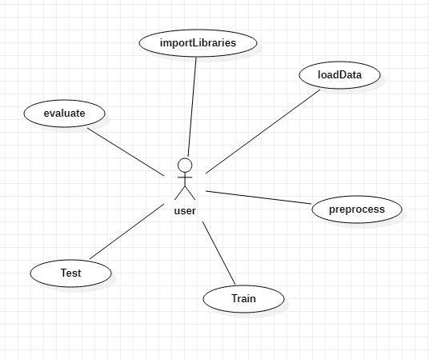
Use Case
Diagram

Slide 13
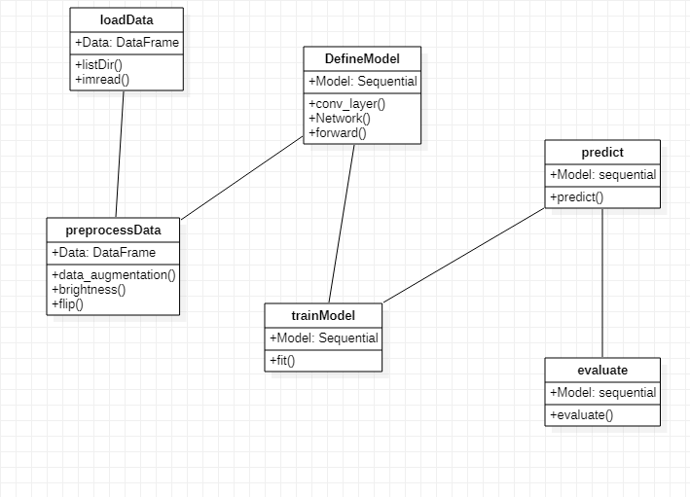
Class
Diagram

Slide 14
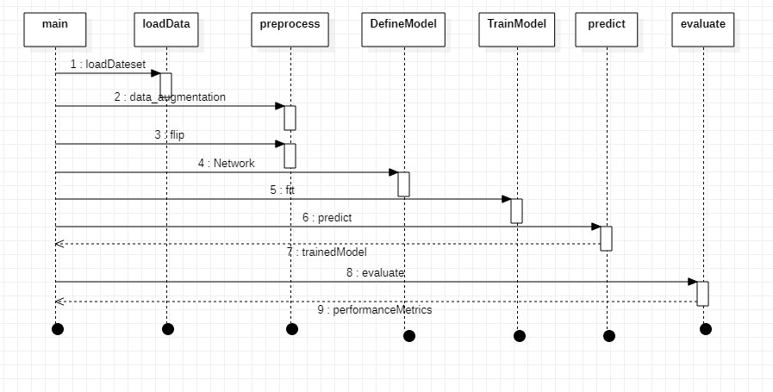
SEQUENCE DIAGRAM

Slide 15
RESULTS

Slide 16
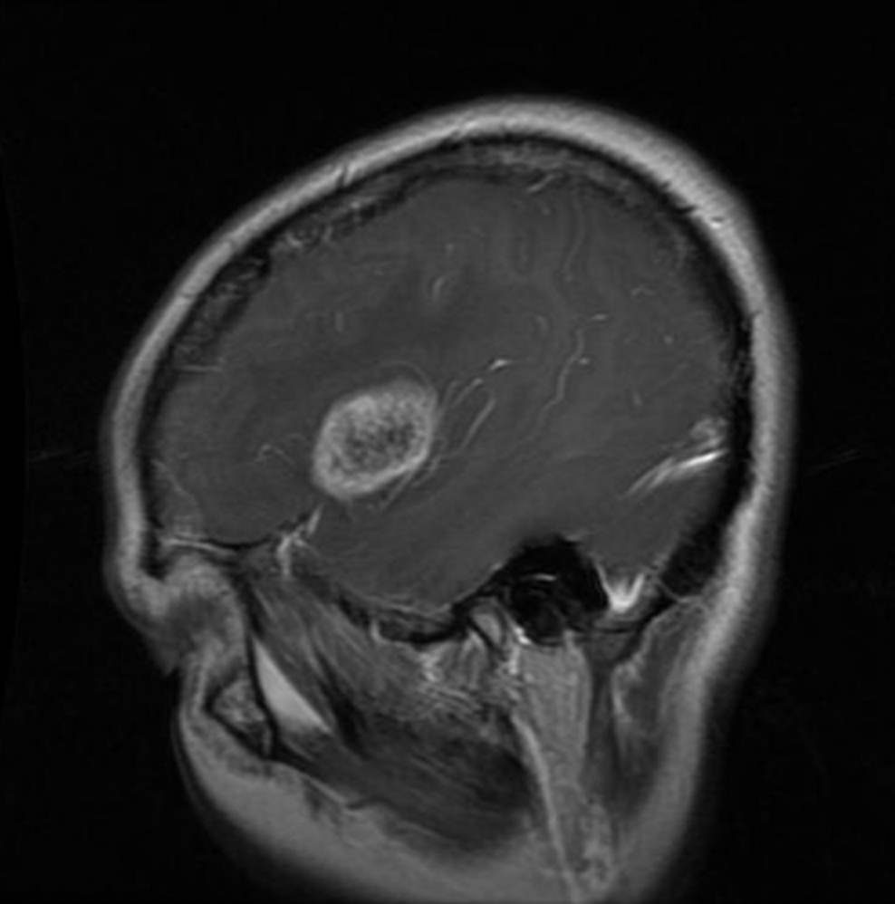
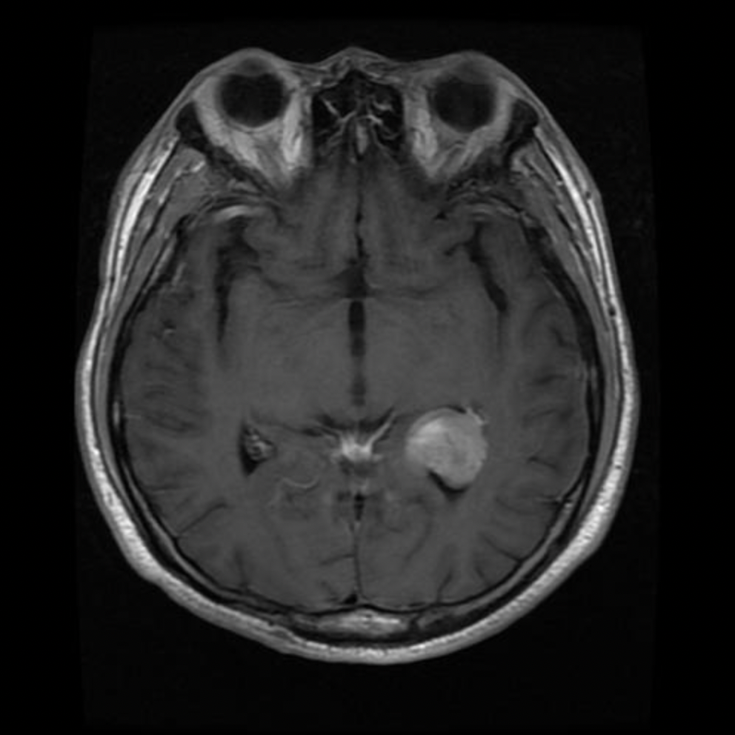
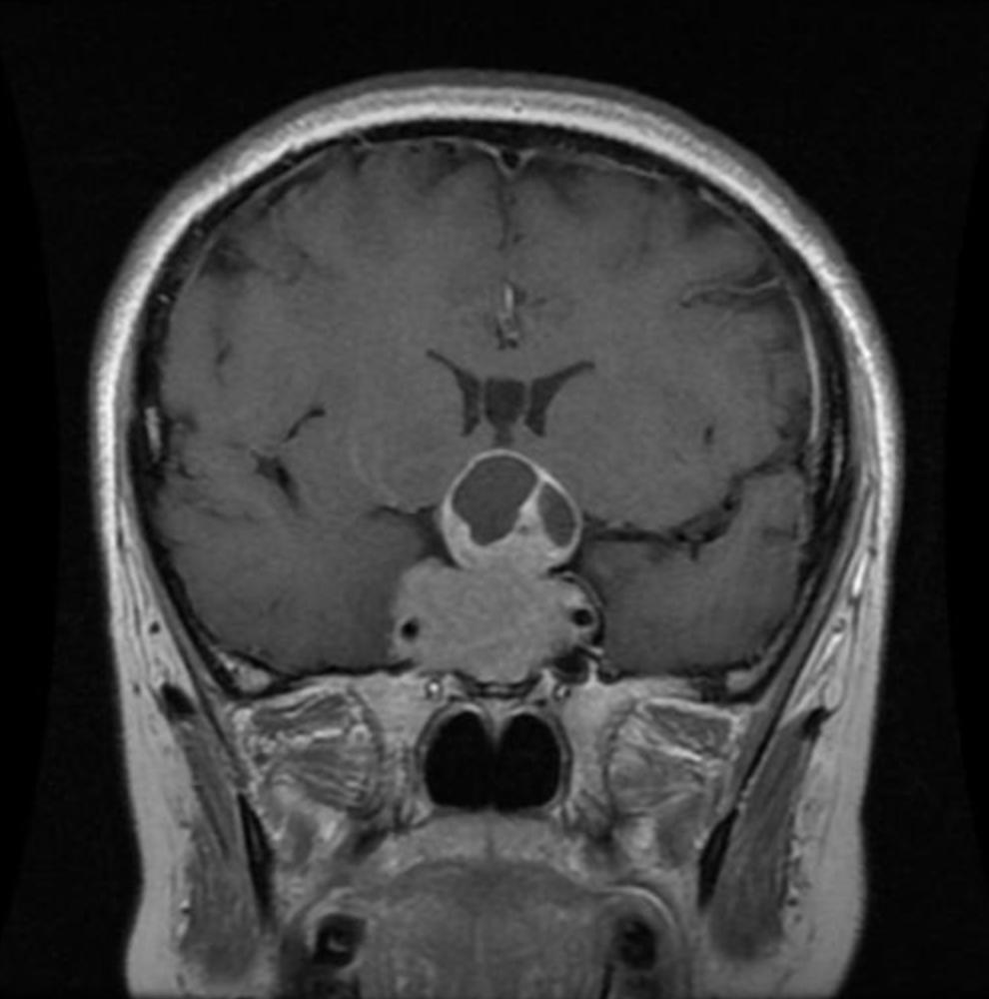
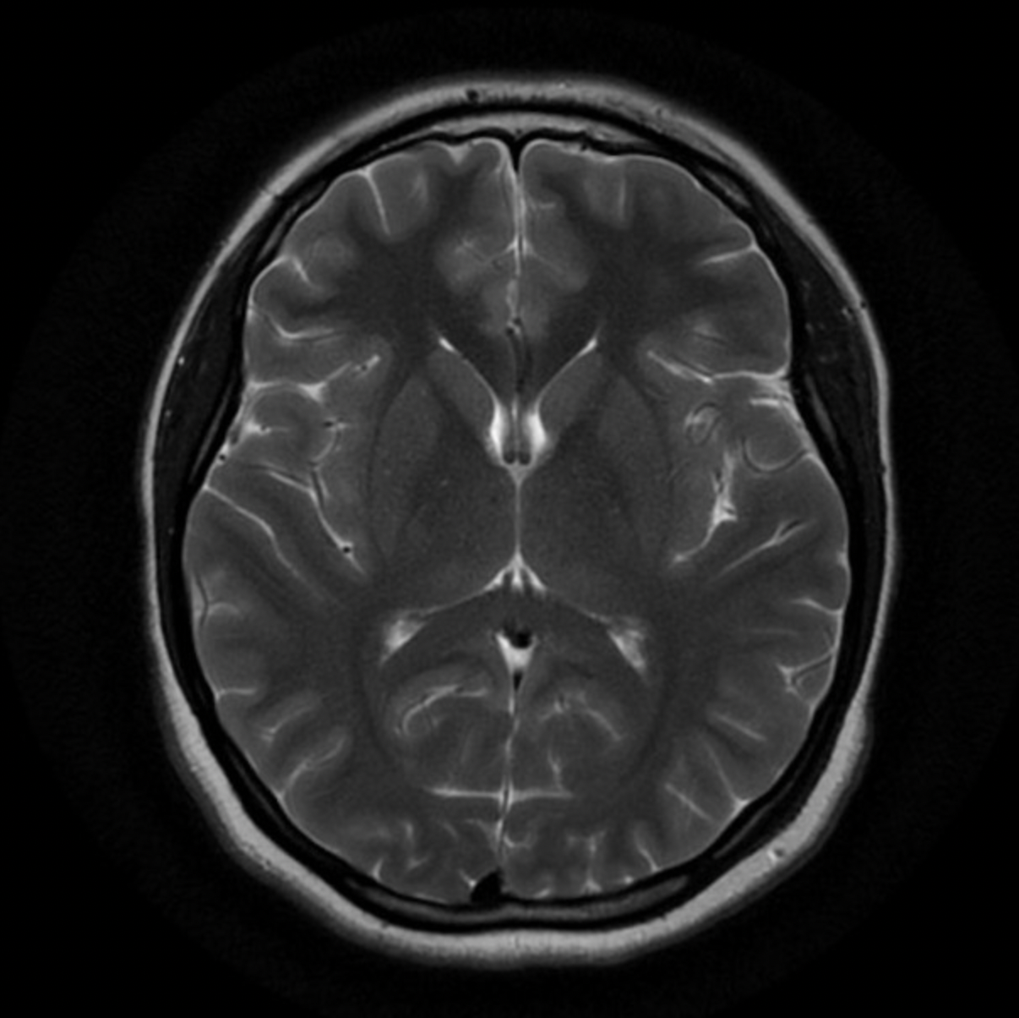
DATASET USED
Collected the data from multiple sources and total number of images present are 2229.
GLIOMA TUMOR - 828 images
MENINGIOMA TUMOR - 247 images
PITUITARY TUMOR - 827 images
NO TUMOR - 327 images

Slide 17
HYPER PARAMETERS
PARAMETER | VALUES
Epoch | 20
Patience | 5
Learning Rate | 1.0E-03
Batch Size | 100
Kernel window size | 3x3
Max Pooling size | 2x2

Slide 18
TRAINING AND VALIDATION LOSS GRAPH

Slide 19
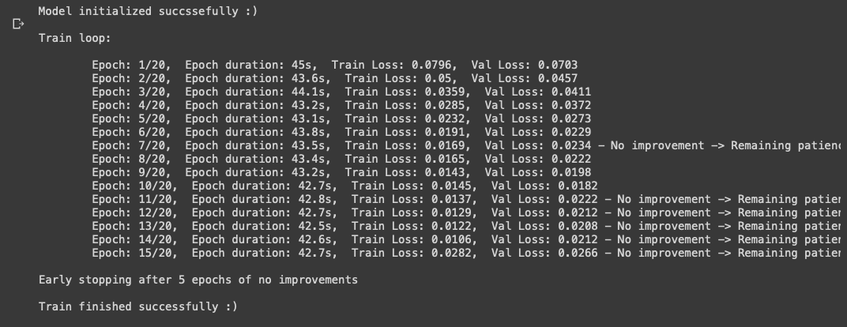
EPOCH REPORT

Slide 20
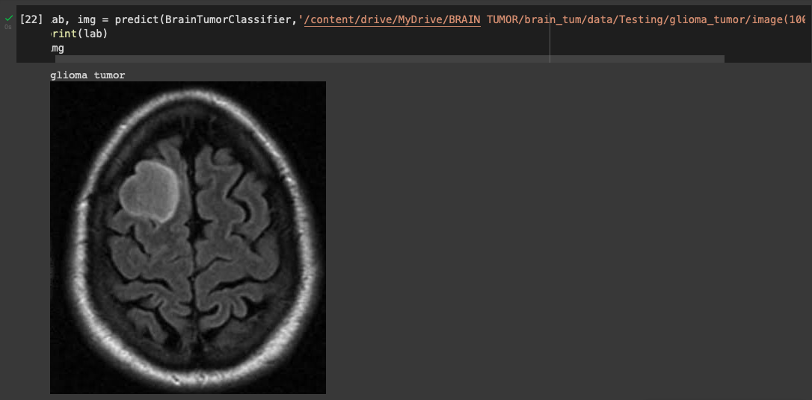
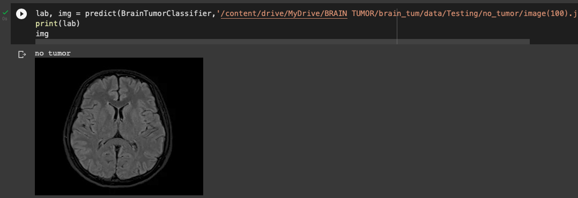
OUTPUT
Glioma Tumor detected
No Tumor detected

Slide 21
SAMPLE GUI

Slide 22
CONCLUSION
This project address problems with existing system and solves them effectively. This a fully functional model that efficiently detects brain tumours and Convolutional neural networks represent a growing field that will likely help radiologists provide more accurate care for their patients.In our work, CNN gained an accuracy of 99.6%, which is very compelling.
FUTURE ENHANCEMENTS
Updates are best to continue the legacy of any applications. For this we propose to integrate into MRI scanners with automatic contours around t area. Through the further development of segmentation techniques in brain tumours, this could be applied to other areas of radiology.Through the further development of segmentation techniques in brain tumours, this could be applied to other areas of radiology.

Slide 23
REFERENCES
For dataset- https://github.com/SartajBhuvaji/Brain-Tumor-Classification-DataSet
https://ieeexplore.ieee.org/document/8934561
https://scikit-learn.org
https://scikit-learn.org/0.21/documentation.html
https://pytorch.org/docs/stable/index.html

Slide 24
THANK YOU

